Slide 1
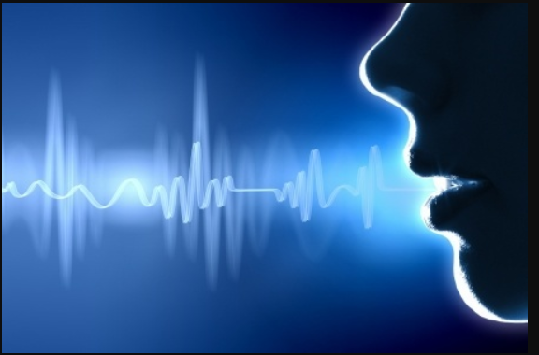
Know UR Caller
The A-Team @ 2021 Unconference & Hackathon
July 2021

Slide 2
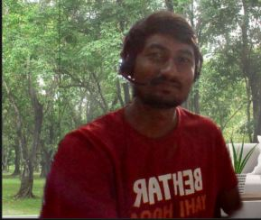
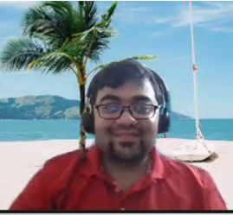
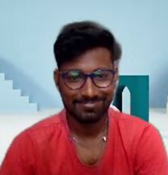
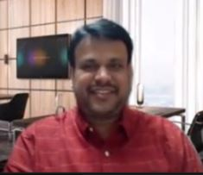
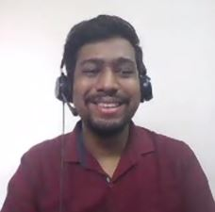
The A-Team
Name: Venkatram Srinivas Reddy
Team: NPS – Analytics team
Role: Tech Lead
Name: Aritra Jyoti Chakraborty
Team: NPS – Analytics team
Role: Product Owner
Name: Aravind Kadaverugu
Team: NPS – Analytics team
Role: Developer
Name: Mallesh Kolanu
Team: NPS – Analytics team
Role: Engineering Manager
Name: Murli Goel
Team: NPS – Analytics team
Role: Developer

Slide 3
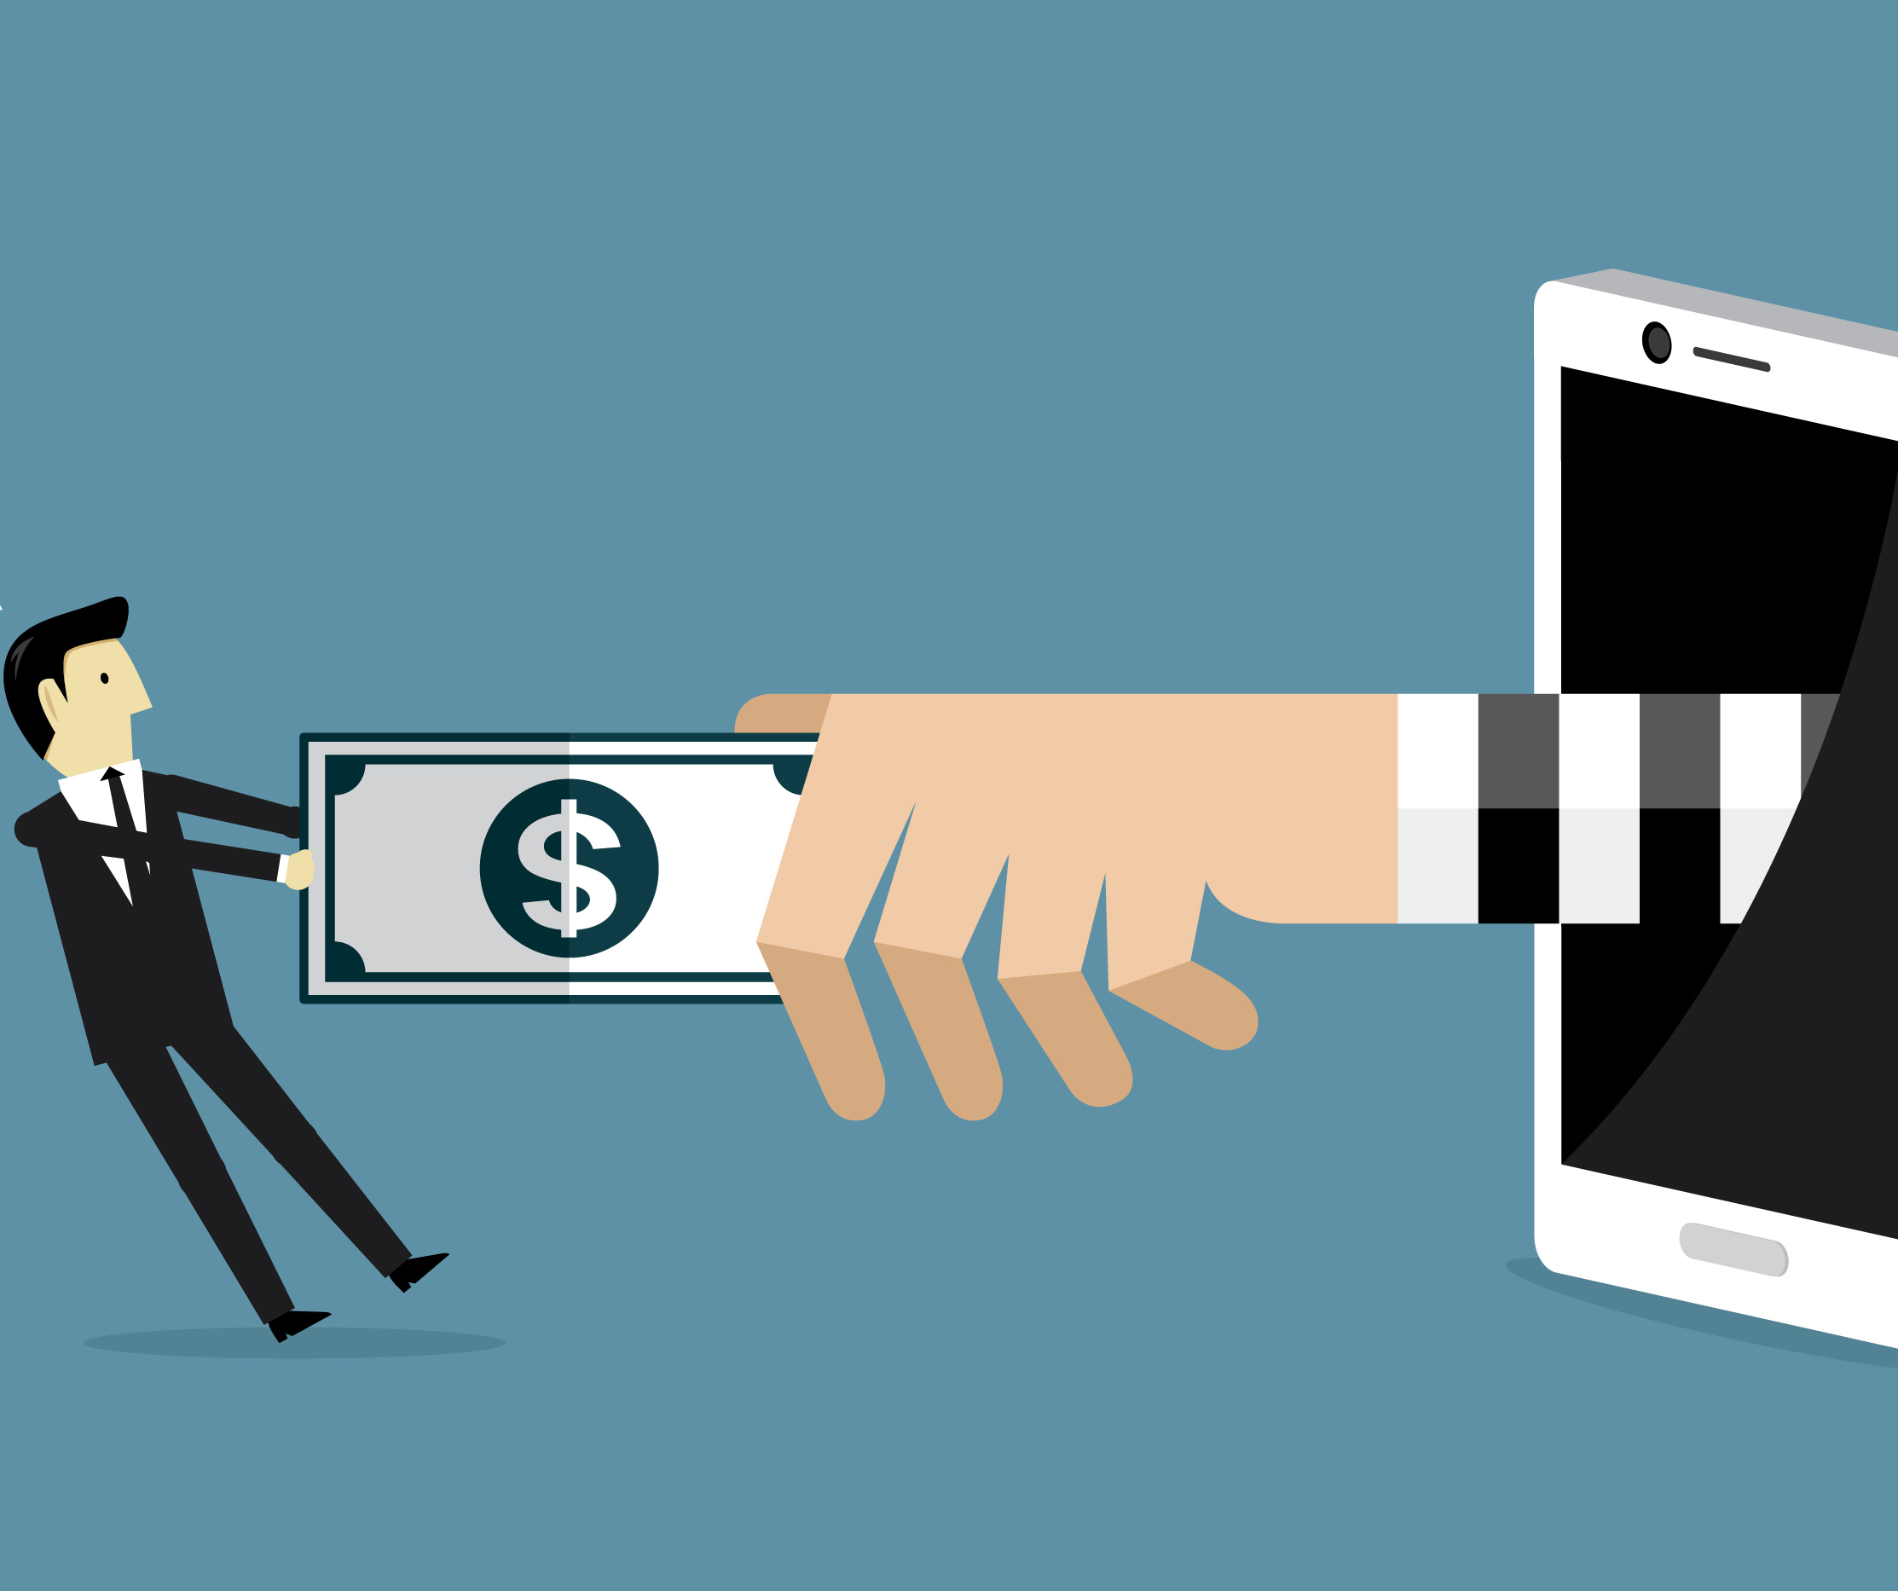
Problem Statement – Phone Scams
Payment card fraud losses reached $28.65 billion worldwide in 2019, according to the most recent Nilson Report data.
With the growth of the e-commerce industry and community, we will see credit card fraud rise at rates faster than ever.
Covid-19 is playing a major role in the explosive growth in credit card fraud activity.
Over 55% of fraud-related complaints listed a method of initial contact out of which 77% were contacted by phone.
Once they get you on the line, phone scammers use false promises, aggressive sales pitches and phony threats to pry loose information they can use to steal your money or identity (or both).
The idea is to address the fraud initiated through voice conversations (telephone, calls through social media platforms etc.) by being able to distinguish between fraudulent and legitimate calls and alert concerned stake holders to prevent fraud.
Source - https://www.idexbiometrics.com/top-7-alarming-facts-and-statistics-on-card-fraud/

Slide 4
Proposed Solution
There are apps, mechanisms to tag certain numbers as 'Spam', but fraudsters are pursuing different ways to dupe consumers from different sources.
The idea we are proposing is to identify the caller based on voice, so that irrespective of source of call, we can identify the caller voice and prevent fraud transactions.
'Know UR Caller' is a mobile app that will identify a caller based on Phone number, Voice & Keywords and provide feedback to the user based on voice recognition/analysis by comparing them with the call records in the database

Slide 5
User workflow
‘Know UR Caller’ has following features
User registration and voice recording of user to differentiate voice of the User & Caller
Setting User preferences – Play an alert tone during the call, Report Spam (to Governance Email/Phone Number) , Block User, Record call
Ability to Add new Keywords, Phone Numbers, Voice recordings
User registers with ‘Know UR Caller’
User receives a call
The call is identified as legitimate, if
The phone number is not registered in fraudulent call records database
If no security information is asked/provided during the conversation
If the voice of the caller is not registered in fraudulent call records database
The call is identified as fraudulent, if
The phone number is registered in fraudulent call records database
If security information is asked/provided during the conversation
If the voice of the caller is registered in fraudulent call records database
If the call is identified as fraudulent, action will be taken as per User preferences
If the context on conversation is interpreted as fraud, but the Phone number/Voice is not registered in fraudulent call records database
Option is provided to report the conversation as fraud

Slide 6
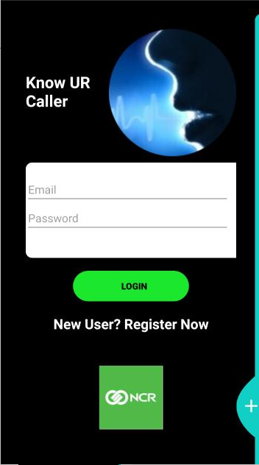
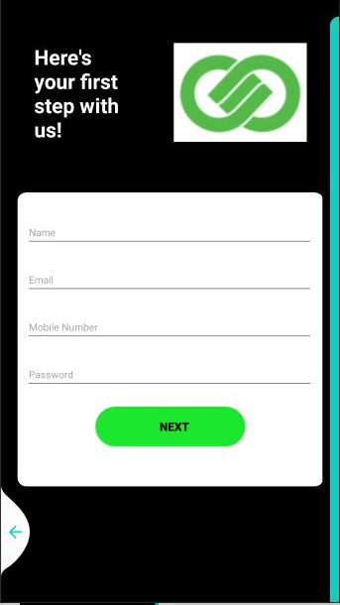
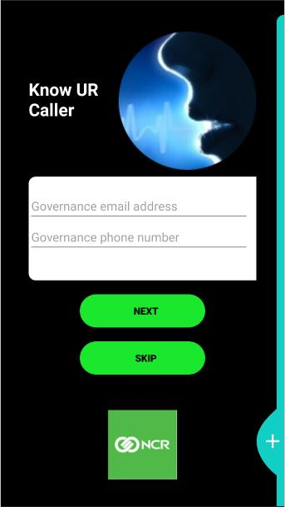
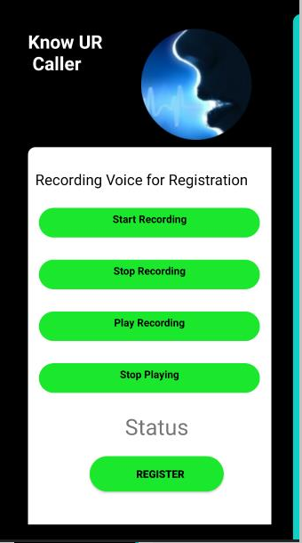
User workflow - Registration

Slide 7
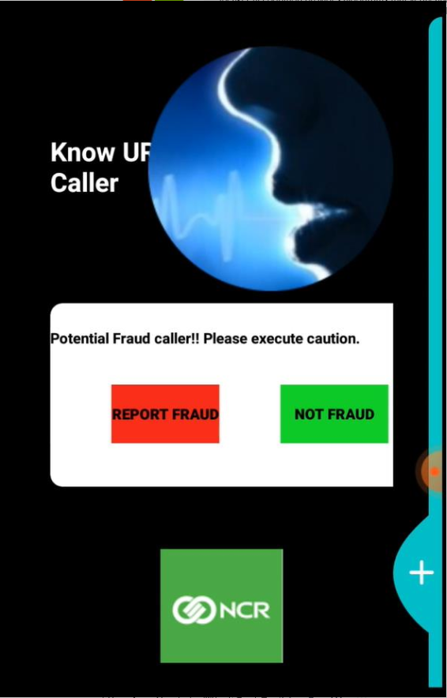
User workflow – Caller Identification

Slide 8
Value
To User
Users will be protected from fraudulent callers and avoid financial losses.
Users are provided with opportunity to contribute for fraud prevention.
To Banks/Merchant
For Banks , this will be an additional security to prevent fraud.
This solutions can help prevent fraud focused on loyalty/gift cards.
Additional security will improve User trust levels and help with increasing loyalty with the Bank/Merchant
To NCR
This feature can be provided as a Service to Banks/Merchants, which can be integrated into apps.

Slide 9
Scalability opportunities
Know UR Caller can be further scaled to
Improve the fraud detection efficiency by adding more actions and integration with AI/ML tools
Add support to multiple platforms. e.g., iOS
Can be extended to multiple domains. e.g., Real Estate Industry

Slide 10
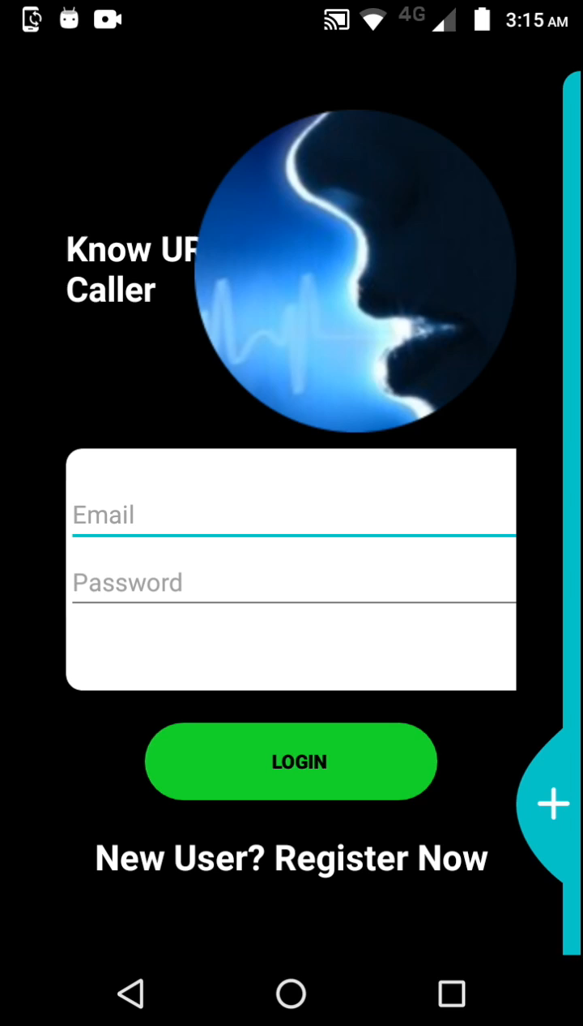
Demo

Slide 11
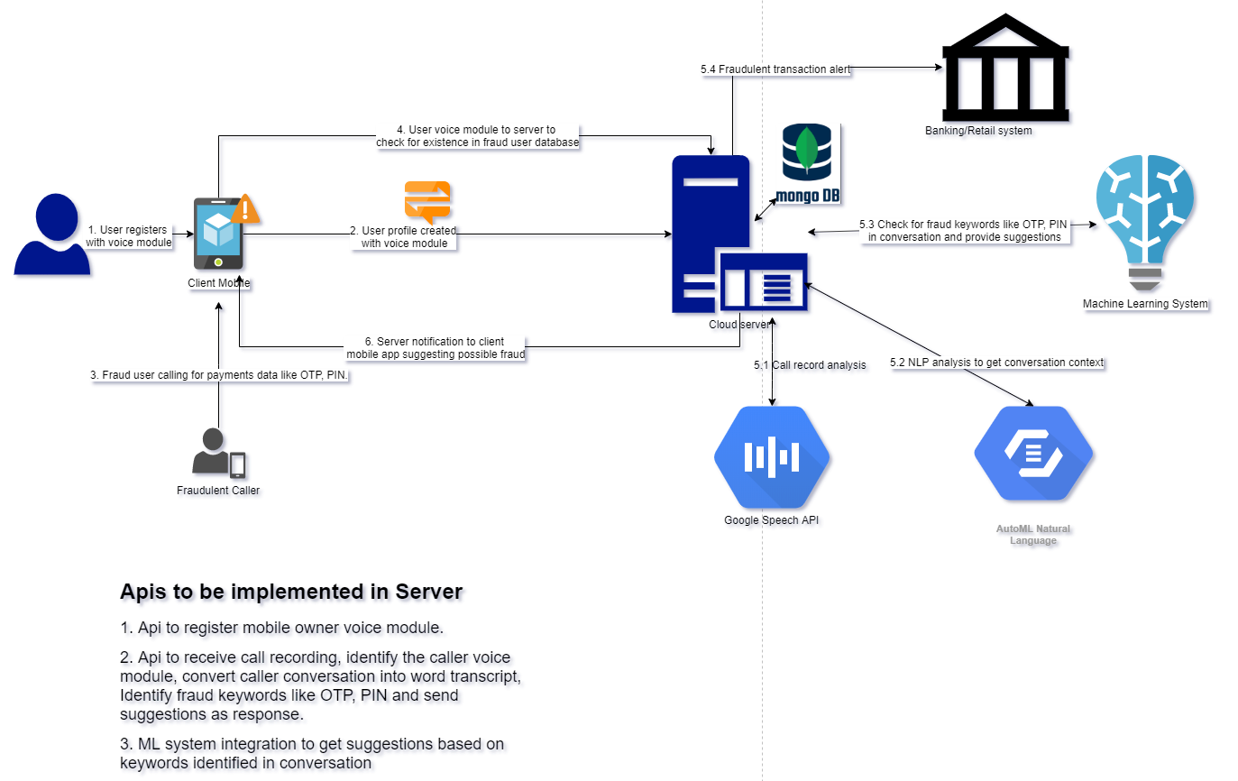
Know UR Caller - Architecture
Technology Stack
- Java Springboot Webservices
- MongoDB
- Google Speech API
- Android

Slide 12
THANK YOU <65% of the time, credit card fraud results in a direct or indirect financial loss for the user>

